Slide 1
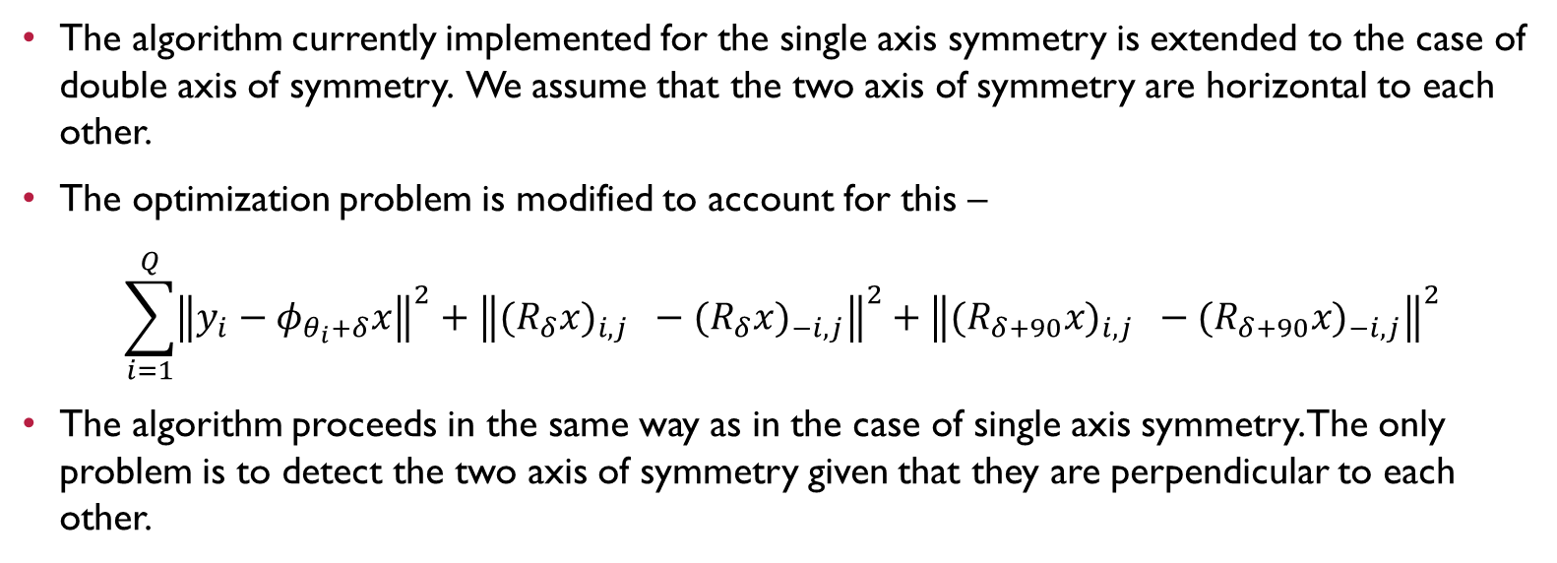
Multiple axis of symmetry
The algorithm currently implemented for the single axis symmetry is extended to the case of double axis of symmetry. We assume that the two axis of symmetry are horizontal to each other.
The optimization problem is modified to account for this –
$$\sum_{i=1}^{Q}{{\left\|y_{i}−φ_{θ_{i}+δ}x\right\|}^{2}}+{\left\|{(R}_{δ}{x)}_{i,j} −{(R}_{δ}{x)}_{−i,j}\right\|}^{2}+{\left\|{(R}_{δ+90}{x)}_{i,j} −{(R}_{δ+90}{x)}_{−i,j}\right\|}^{2}$$
The algorithm proceeds in the same way as in the case of single axis symmetry. The only problem is to detect the two axis of symmetry given that they are perpendicular to each other.

Slide 2
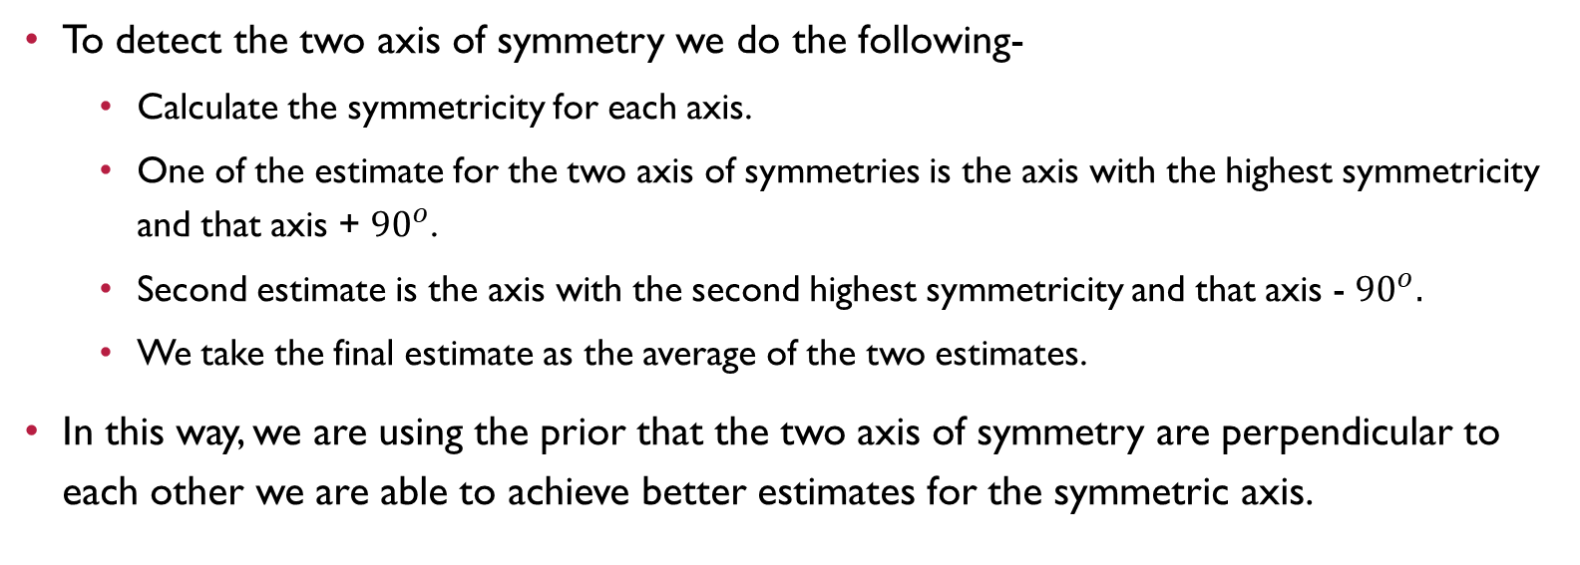
Detecting two axis of symmetries
To detect the two axis of symmetry we do the following-
Calculate the symmetricity for each axis.
One of the estimate for the two axis of symmetries is the axis with the highest symmetricity and that axis + ${90}^{o}$.
Second estimate is the axis with the second highest symmetricity and that axis - ${90}^{o}.$
We take the final estimate as the average of the two estimates.
In this way, we are using the prior that the two axis of symmetry are perpendicular to each other we are able to achieve better estimates for the symmetric axis.

Slide 3
Improvements - Single Symmetry axis
Apart from extending the algorithm to the case of double axis, multiple improvements have been made to the core structure of the program.
For example, in previous versions of the algorithm, at each iteration it was maintained that the axis of symmetry remains horizontal for ease of calculation of gradient.
This unfortunately led to unnecessary quantization errors in other steps of the algorithm.
To negate the effect of these quantization errors we don’t force the symmetry axis to be horizontal. Instead the gradient of symmetry is calculated for an arbitrary axis.
This approach is more consistent with the alternating minimization routine and leads to better results.

Slide 4
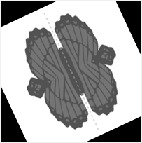
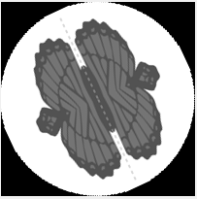
Improvements - Single Symmetry axis
The symmetry measurement and the symmetry gradient are computed on a circular patch with the center as same as that of the image.
This is to avoid the influence of arbitrary black patched on the values of the estimation due to symmetry constraint.

Slide 5
Improvements - Single Symmetry axis
Due to changed above almost all the major functions such as calculating the axis of symmetries, calculating the optimization function needed to be rewritten.
Other minor improvements –
The search space is gradually reduced at each iteration as our confidence in the estimates is increases.
Bugs such as the correct calculation of RMSE is changes throughout the code base.
More extensive logging of data to allow for debugging
Refinement of gradient descent parameters (takes time due to the long runtimes of the code)

Slide 6
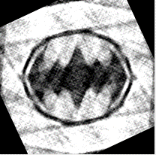
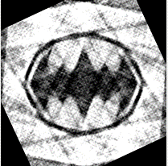
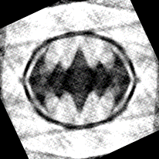
Single AXIS OF Symmetry
Uniform distribution of angles
Number of angles – 20000
Noise level – 30%
Number of clusters – 180
Relative reconstruction error
Refinement without using symmetry | 42.92%
Refinement using symmetry | 40.24%
Refinement without using symmetry
Estimate returned by HLCC
Refinement using Symmetry

Slide 7
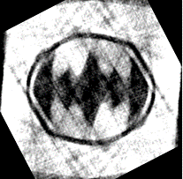
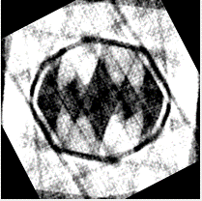
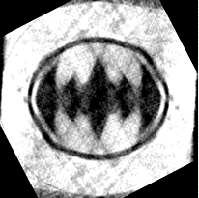
Single AXIS OF Symmetry
Non-Uniform distribution of angles
Number of angles – 20000
Noise level – 30%
Number of clusters – 180
Relative reconstruction error
Refinement without using symmetry | 65.63%
Refinement using symmetry | 61.55%
Refinement without using symmetry
Estimate returned by HLCC
Refinement using Symmetry

Slide 8
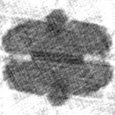
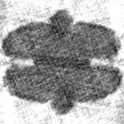
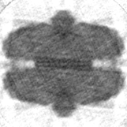
Double AXIS OF Symmetry
Uniform distribution of angles
Number of angles – 20000
Noise level – 30%
Number of clusters – 180
Relative reconstruction error
Refinement without using symmetry | 41.20%
Refinement using symmetry | 36.78%
Refinement without using symmetry
Estimate returned by HLCC
Refinement using Symmetry

Slide 9
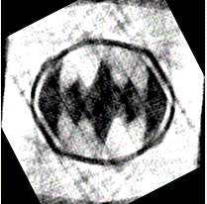
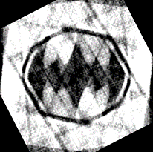
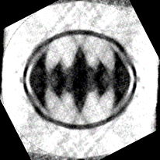
Double AXIS OF Symmetry
Non-Uniform distribution of angles
Number of angles – 20000
Noise level – 30%
Number of clusters – 180
Relative reconstruction error
Refinement without using symmetry | 64.63%
Refinement using symmetry | 61.66%
Refinement without using symmetry
Estimate returned by HLCC
Refinement using Symmetry

